Slide 2
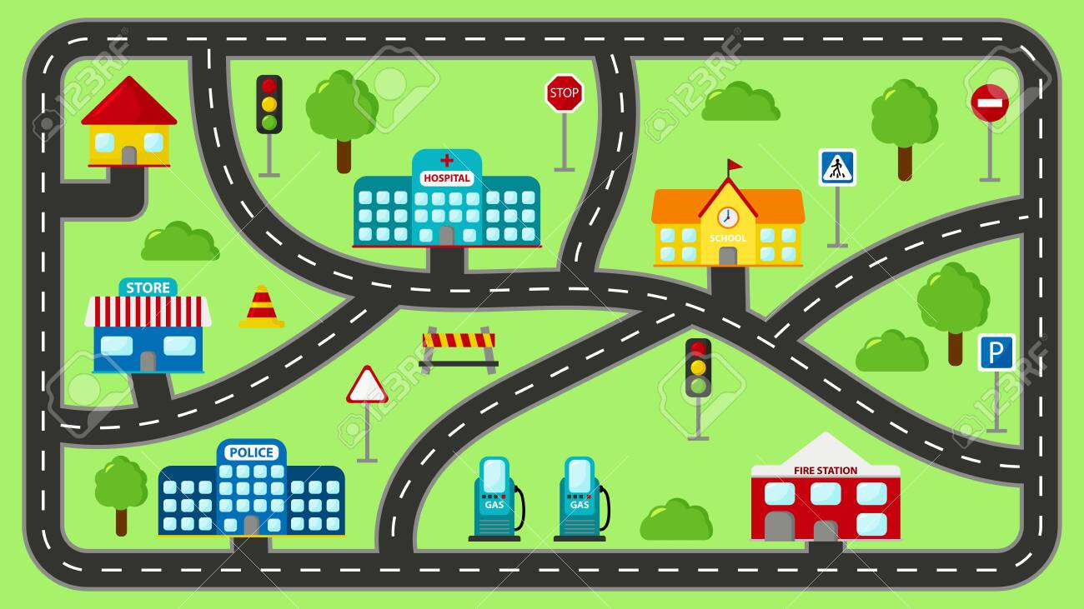
Segmentation
The algorithm simulates driving a car in high speed on a road in the shape of the stroke and detect collisions.

Slide 3
Algorithm
Step 1: Defining the car-
1. speed
2. maximum steering angle
Step 2 :Getting the vector direction of the road
direction of a vector pointing from a point n points behind the current position of car to the current position of the car

Slide 4
Step 3: Predicting the position of the car after 1 unit time
Assuming straight road
use speed of car and direction of road
Step 4: Detecting turn in road
Angle between predicted road and actual road
This is the angle that the car need to steer to stay on road

Slide 5
Step 5: Checking for segment end
If the angle in step 4 is more than the steering angle of the car, we mark the end of the segment

Slide 6

Extracting features from segments

Slide 7

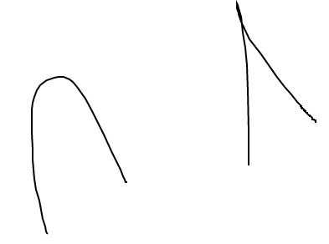
1. Number of segments
Segments break at sharp edges
Similar signatures will have same number of segments

Slide 8
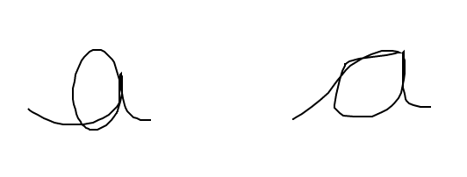
2. Average speed of each segment
Instead of just matching speed of entire signature, we go 1 step ahead and match the speed of each segment
People have different ways of writing different alphabets, copying others makes one slow

Slide 9
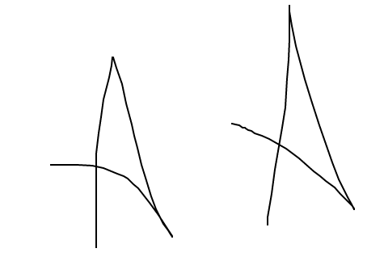
3. Ratio of sum of angles in the segment and sum of absolute angles in the segment
Copied signature differs the original signature in terms of how much a segment curves in any direction

Slide 10


4. Ratio of sum of angles and sum of absolute angles in the whole signature
This features combines with feature 2 (segment-wise ratio of angles) to generate good insight into the signature as a whole

